Slide 1
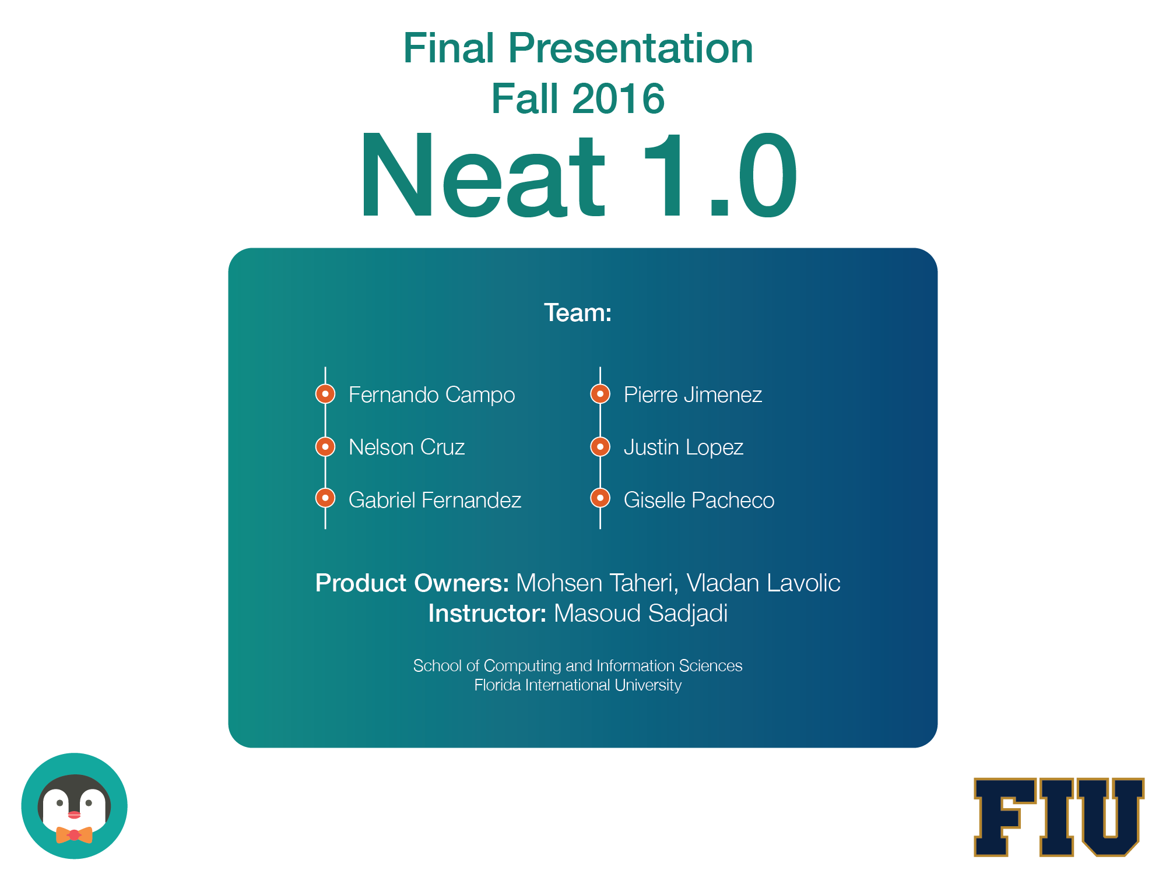

Slide 2
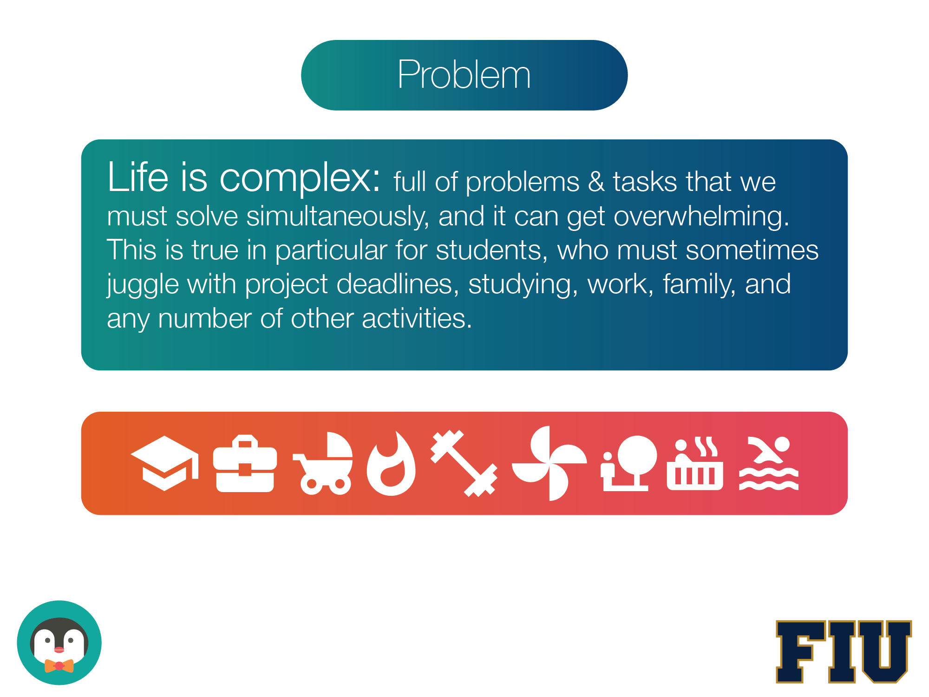

Slide 3
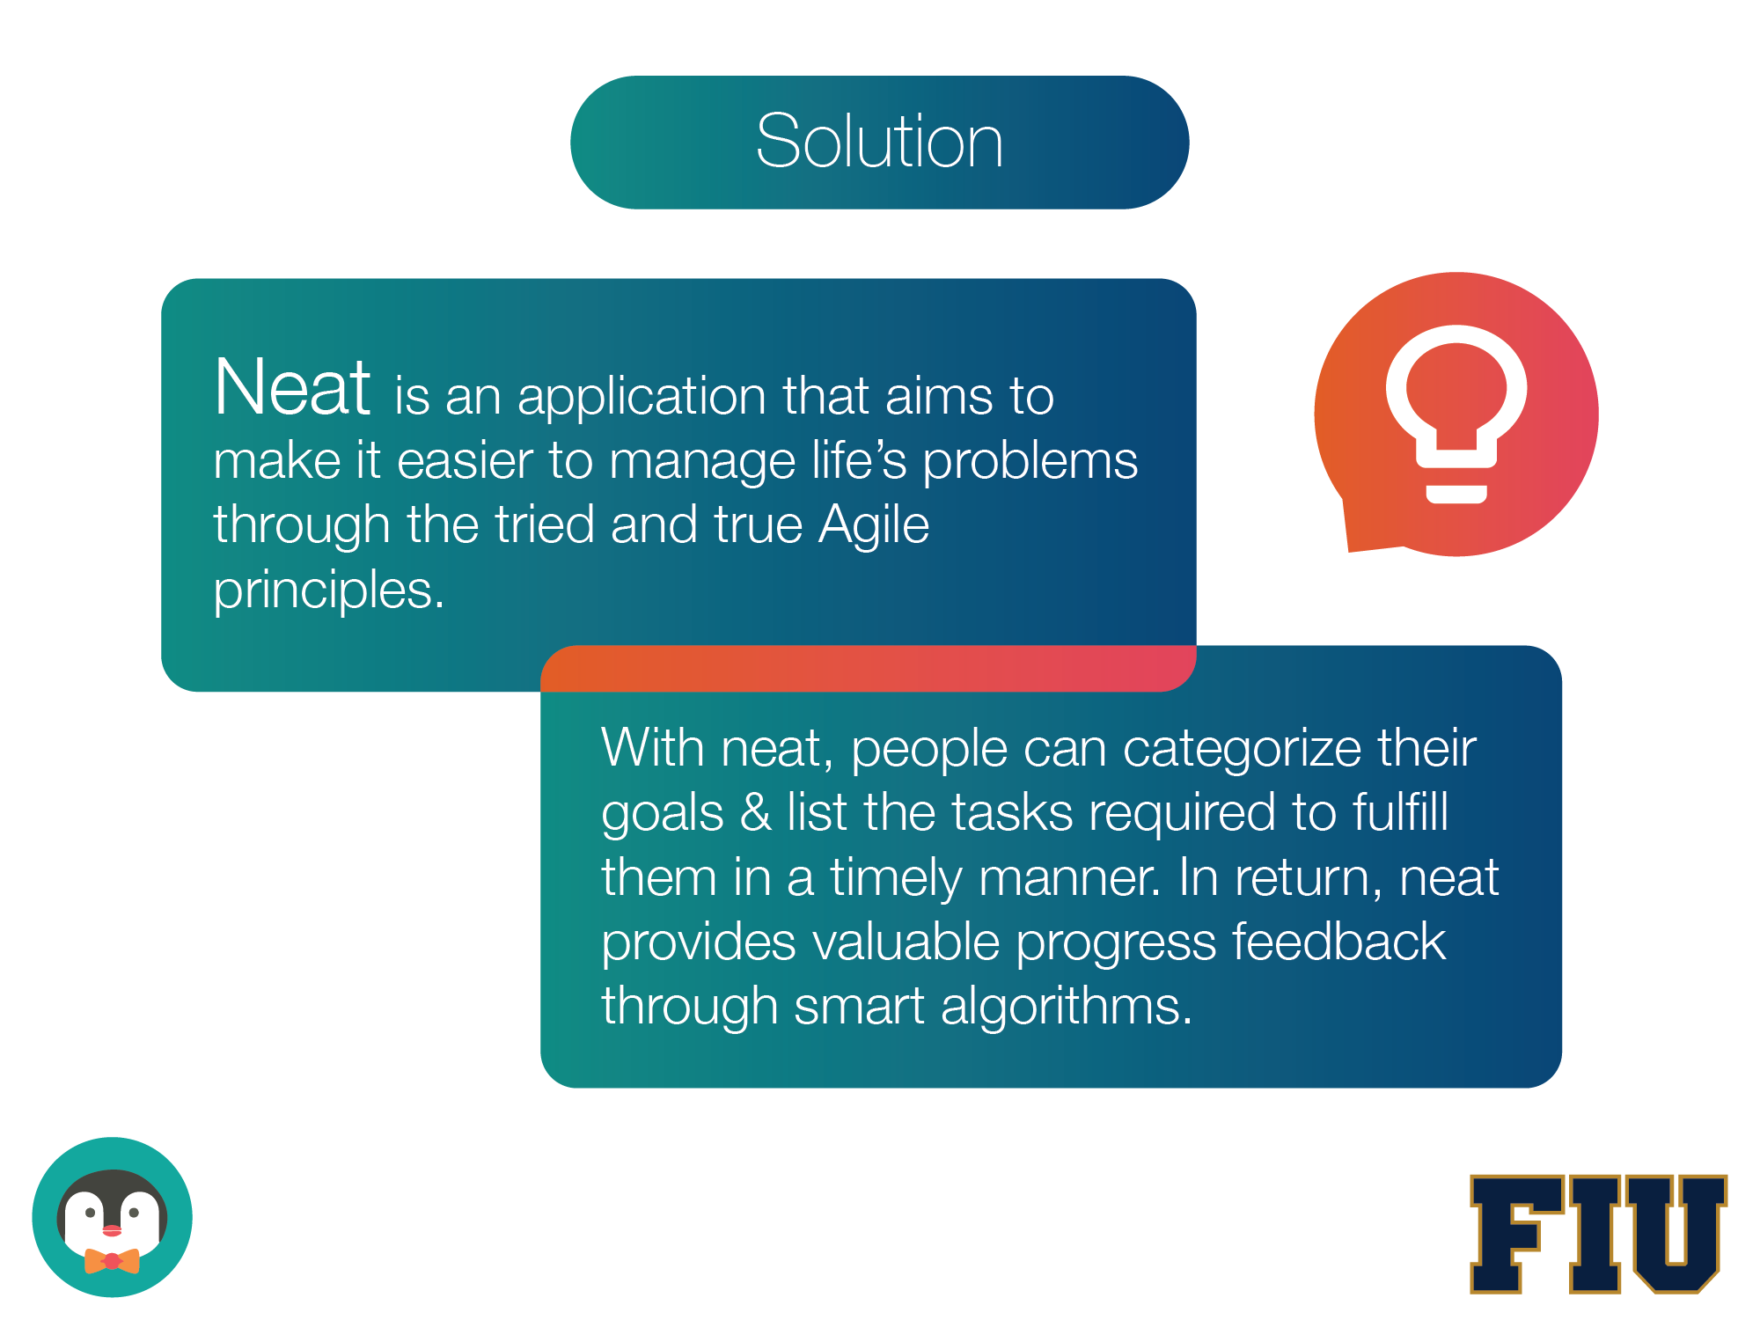

Slide 4
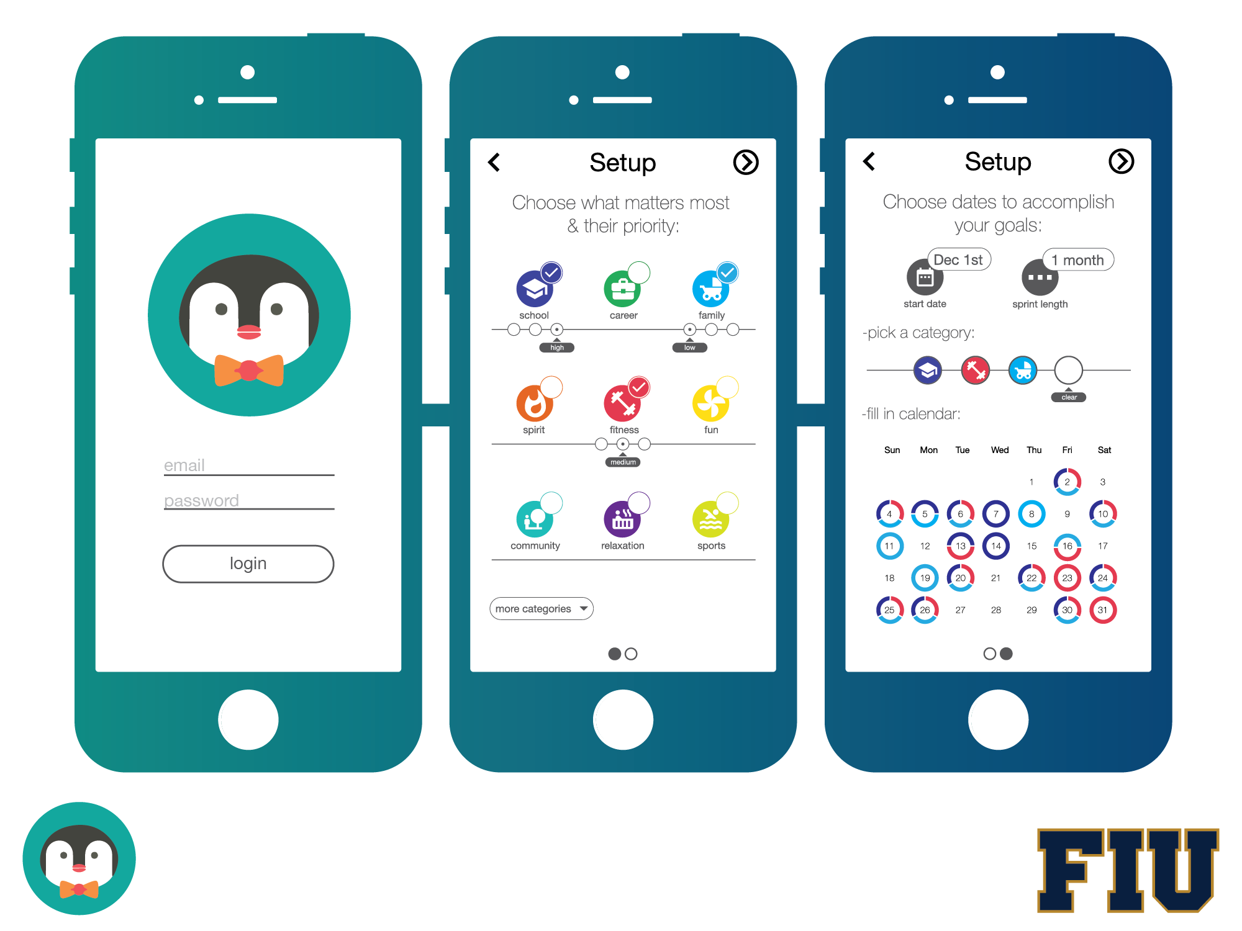

Slide 5
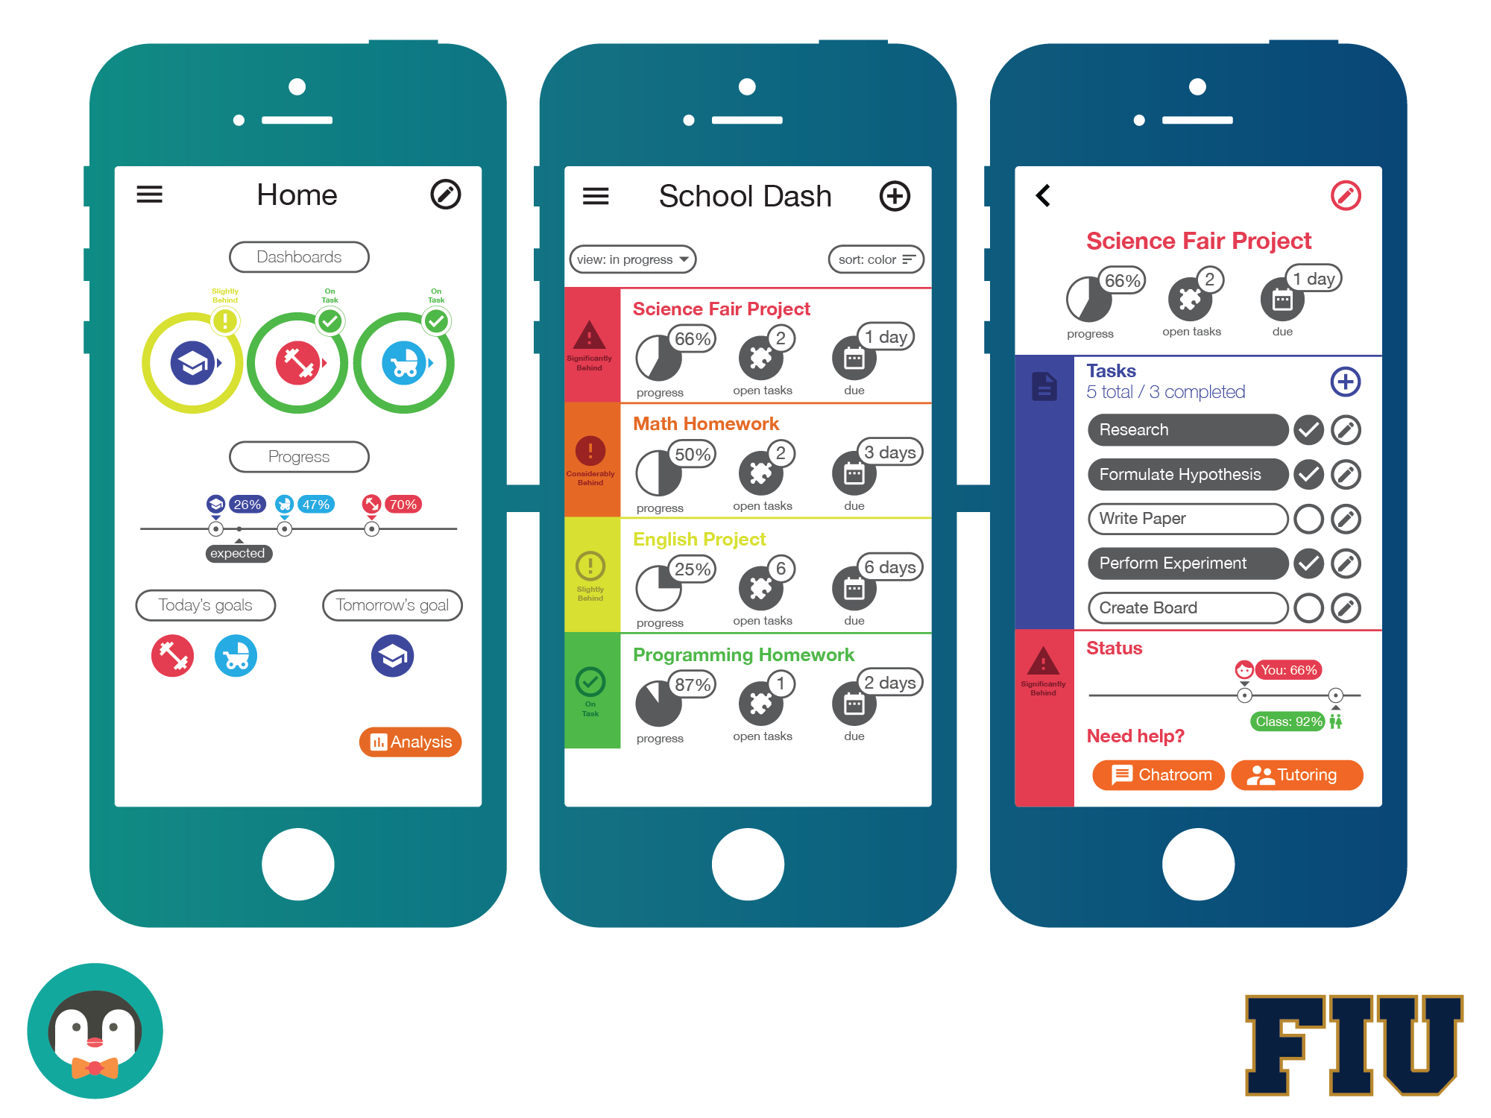

Slide 6
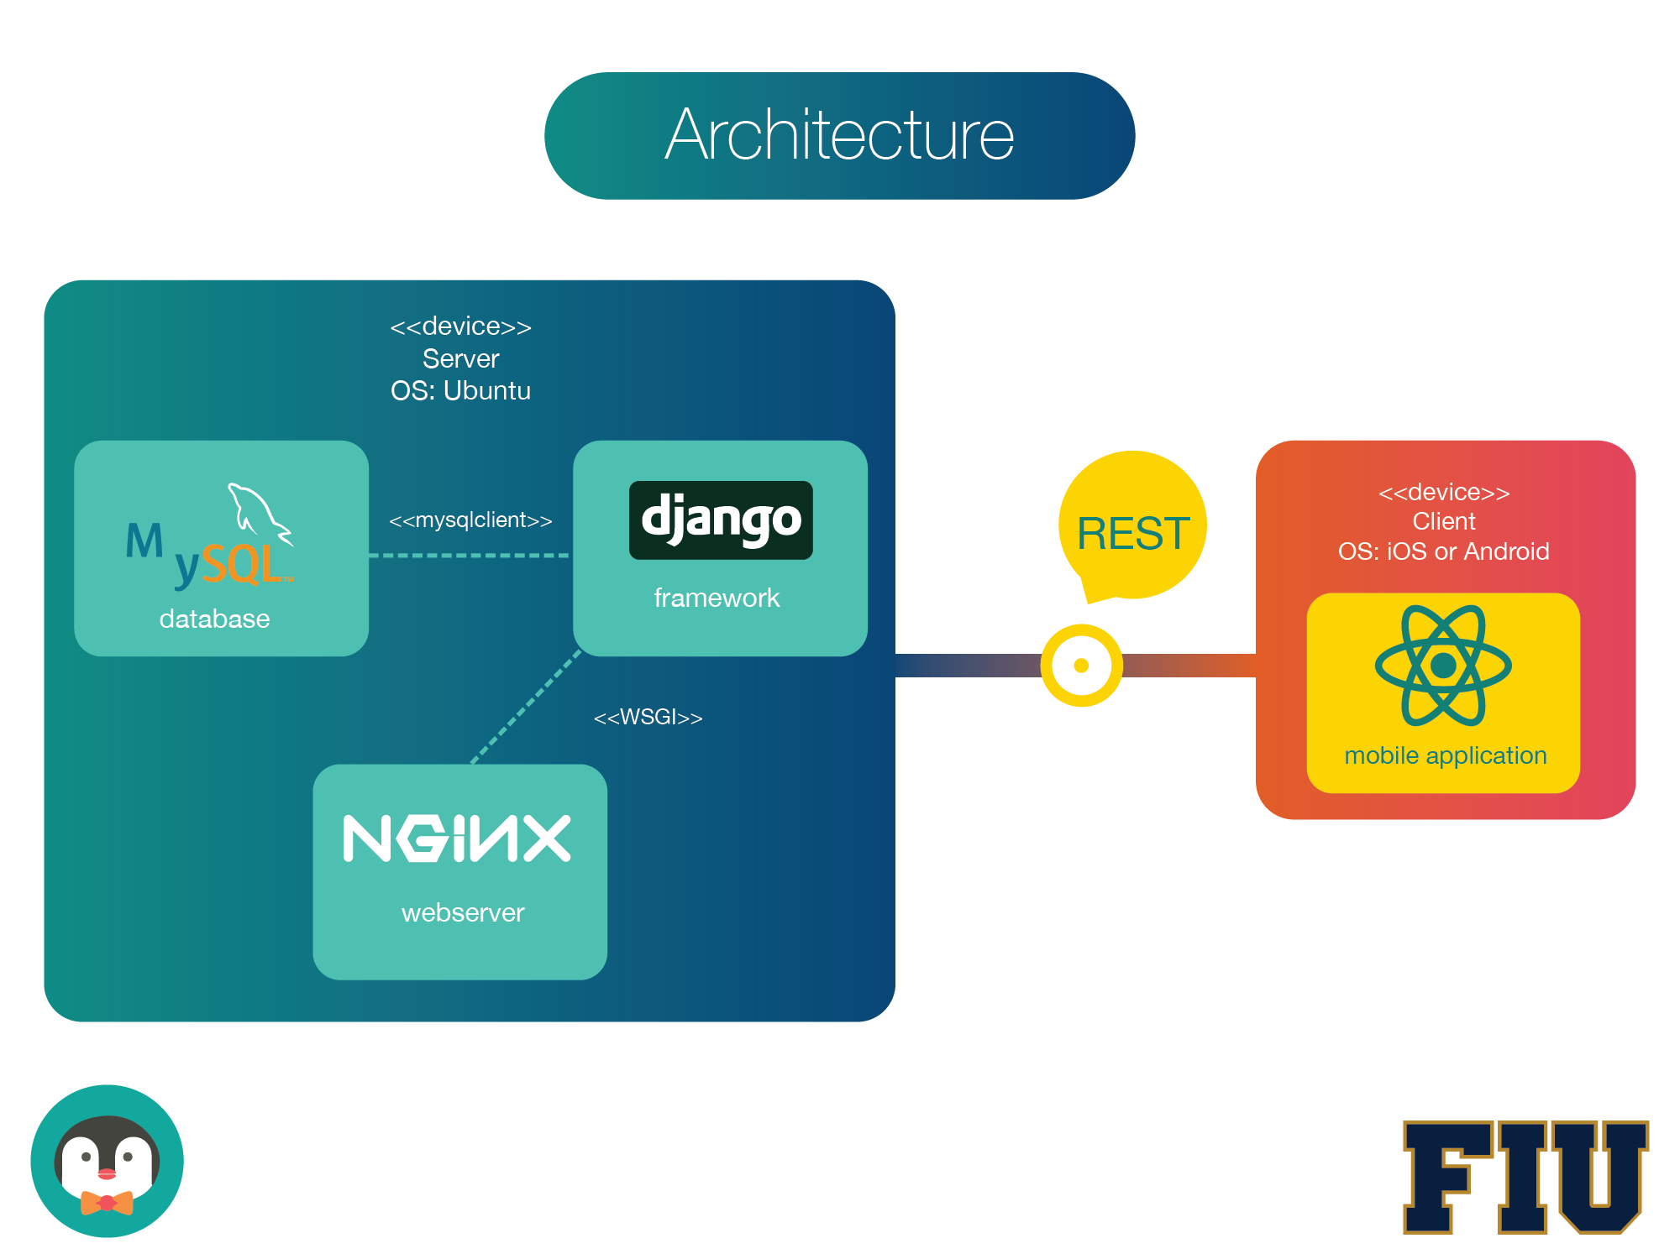

Slide 7
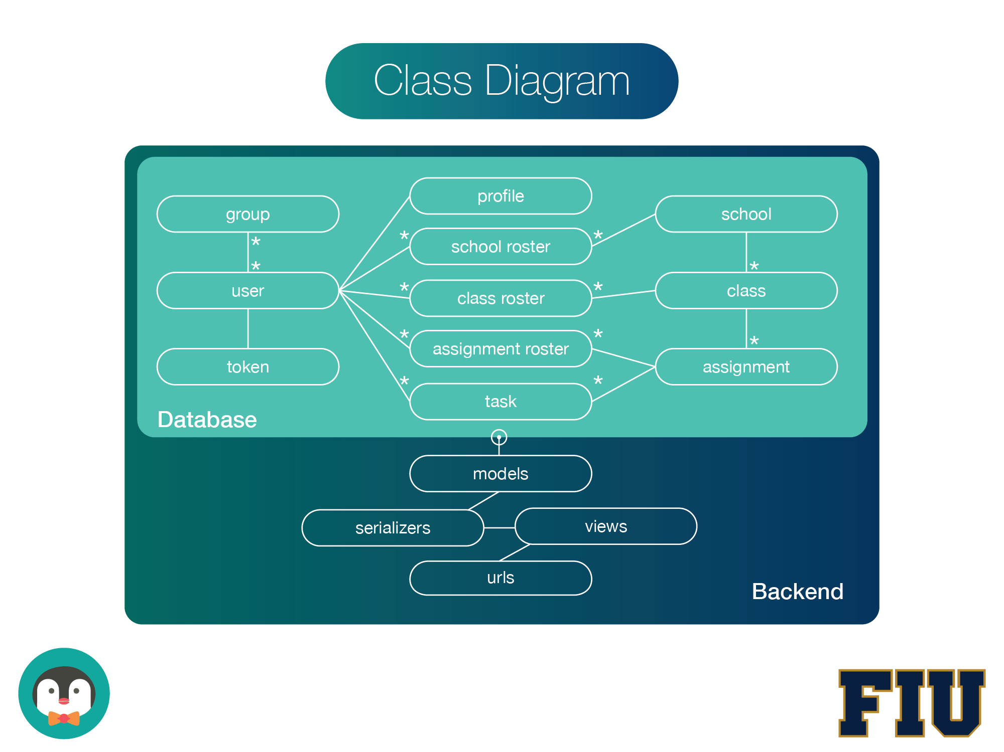

Slide 8
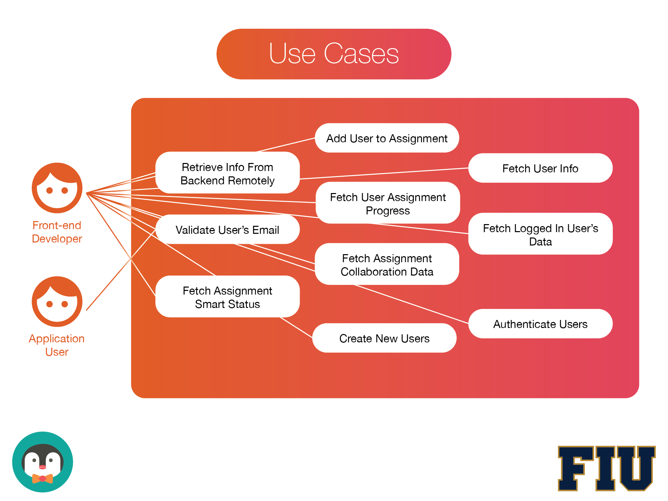

Slide 9
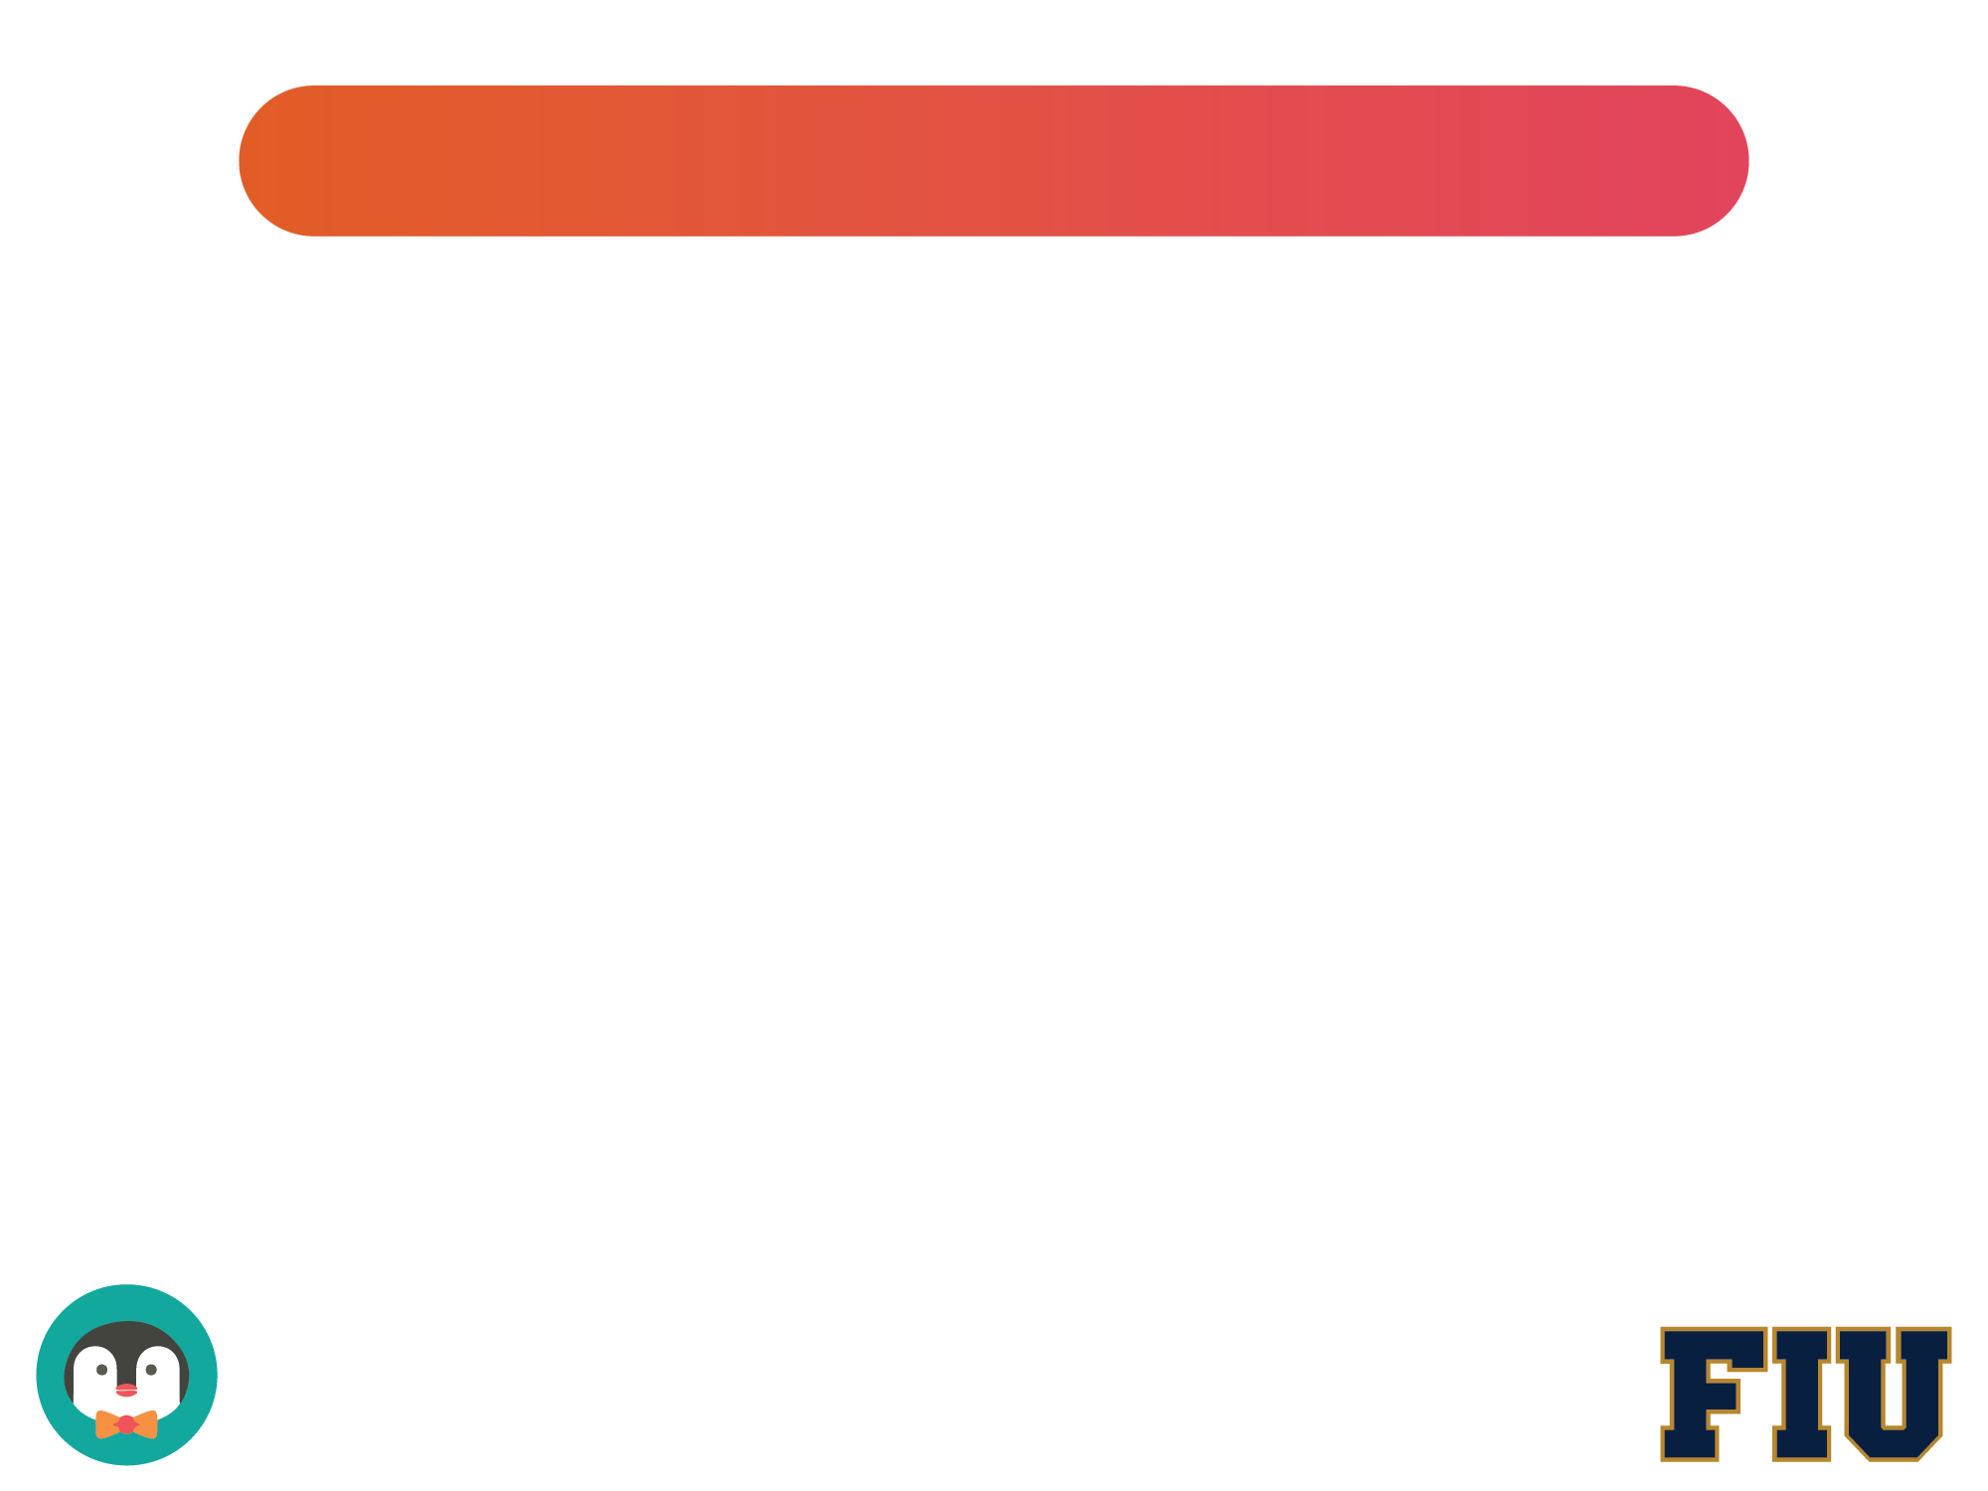
User Stories
Register New Account
2. Create Assignment Dashboard
3. View Assignment
4. Add New Assignment
5. Show Progress
6. Update Progress
7. NeatStudy Webpage
8. NeatStudy Team Page

Slide 10
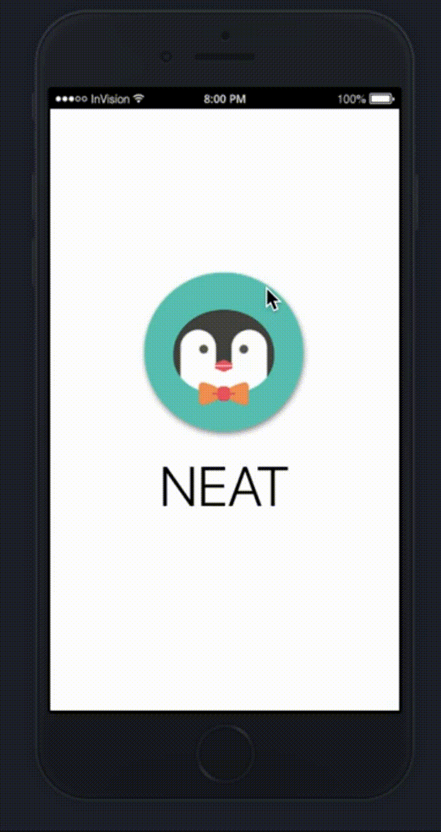
User Story #1 - Register New Account

Slide 11
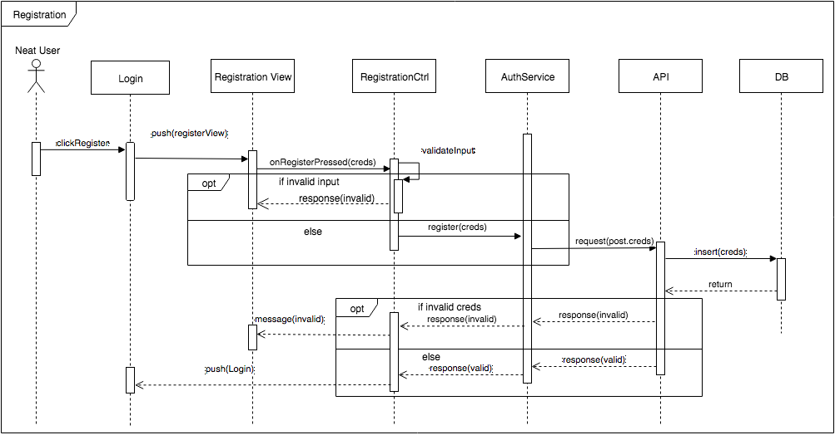
User Story #1 - Create Login Screen

Slide 12
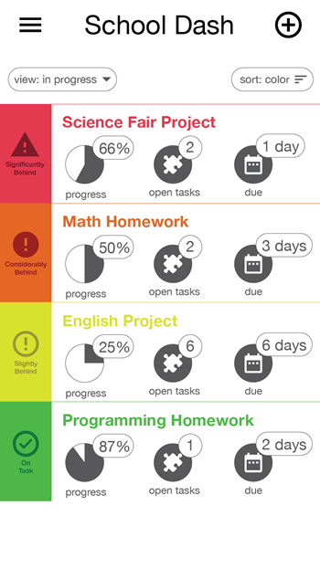
User Story #2 - Create Assignment Dashboard

Slide 13
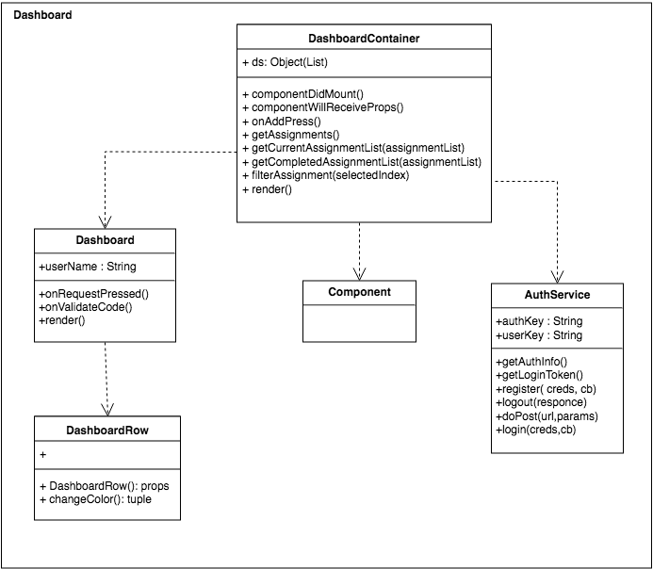
User Story #2 - Create Assignment Dashboard

Slide 14
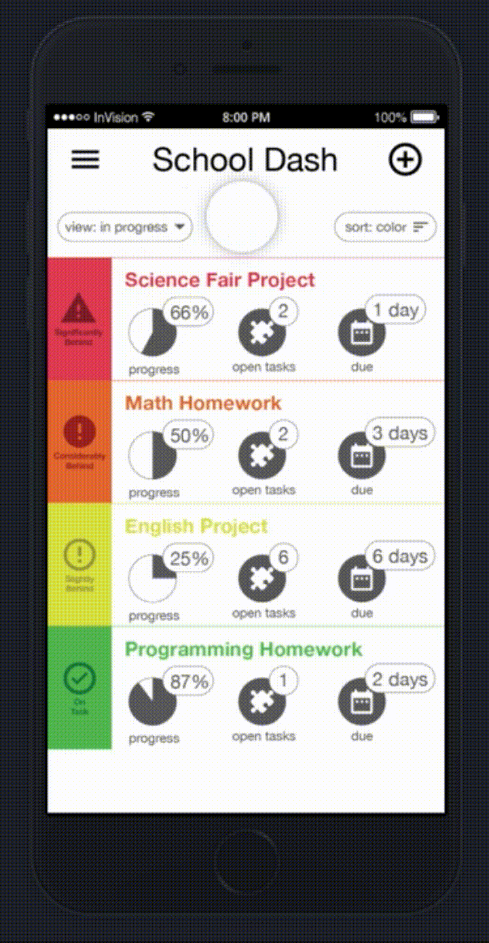
User Story #3 - Assignment View

Slide 15

User Story #4 - Add new Assignment

Slide 16
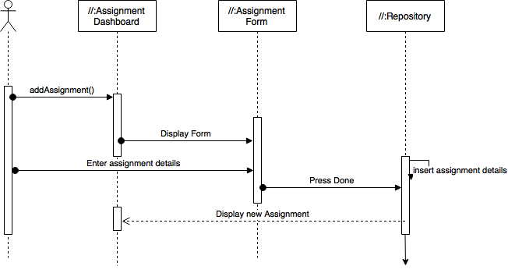
User Story #4 - Add new Assignment

Slide 17
User Story #5 - Show Progress

Slide 18
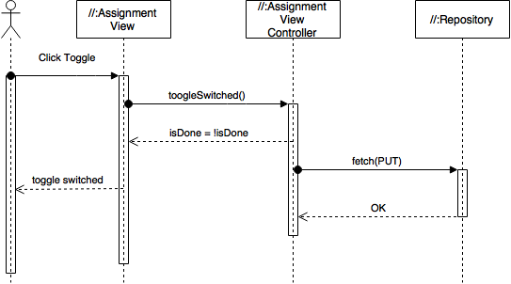
User Story #6 - Update Progress

Slide 19
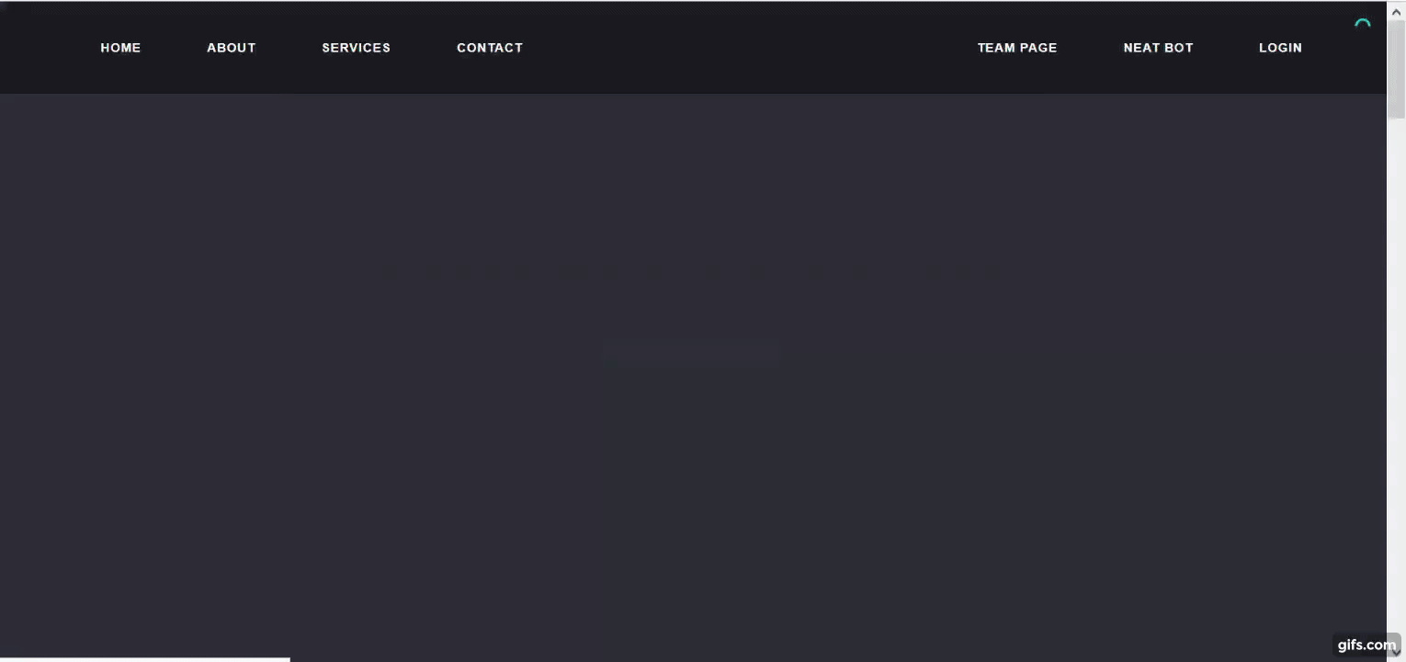
User Story #7 - NeatStudy Webpage

Slide 20
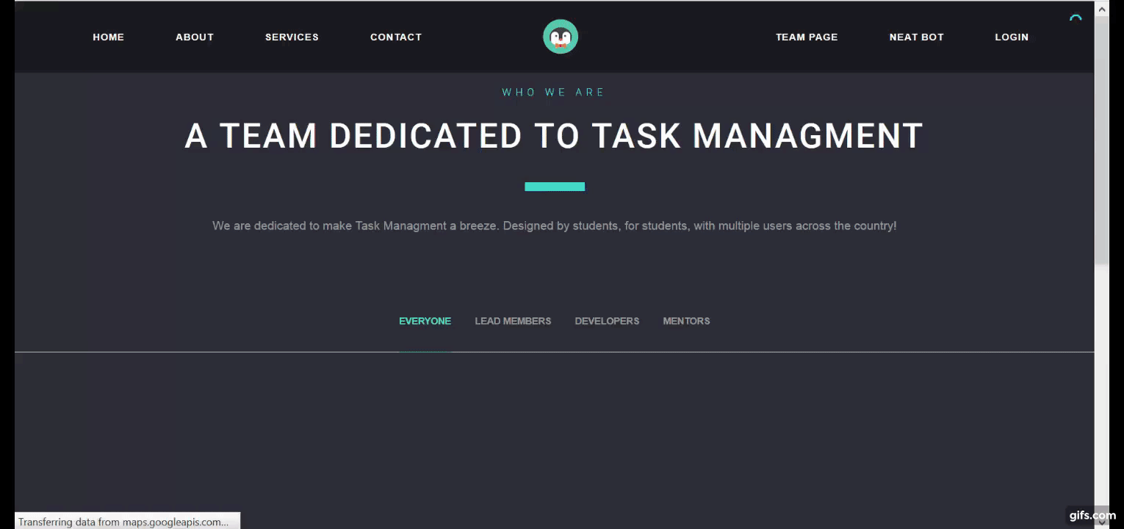
User Story #8 - NeatStudy Team Page

Slide 21
User Story #7 & 8 - NeatStudy Webpage

Slide 22
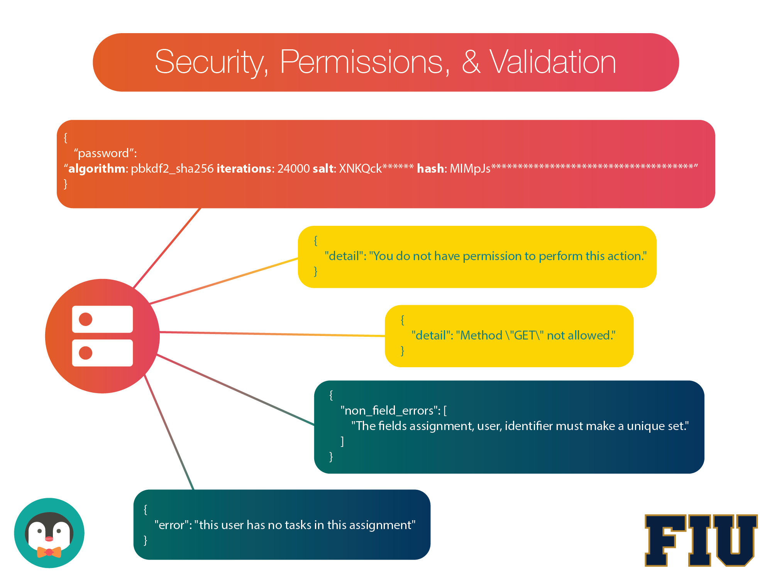

Slide 23





Summary
Summary
contact information
Questions?
Thank You!

